Slide 1
Internship Assignment – Animemangatoon.com
Cloud Computing Candidate Assignment:
Project Overview :
The primary objective of this project is to develop a scalable, robust, and secure web application capable of handling high traffic with minimal downtime. The application will be hosted on Amazon Web Services (AWS), utilizing Elastic Beanstalk, EC2, and RDS to ensure dynamic resource scaling, high availability, and efficient resource management. This infrastructure will enable the application to adjust its capacity automatically based on real-time traffic, ensuring optimal performance and cost-effectiveness.
Name of the candidate:
Chitra Sri Krishna Prasanna AWS/Code

Slide 2
Assignment Technologies:
The project encompasses the following components:
Web Application Development:
Building a responsive, user-friendly web application for end-users.
Ensuring efficient load handling and session management.
Elastic Beanstalk for Deployment:
AWS Elastic Beanstalk will be used to deploy and manage the application automatically.
Simplifies scaling by adjusting the environment based on traffic demands.
EC2 Instances:
Using EC2 for compute resources, with the ability to auto-scale as traffic increases.
EC2 will provide the backbone for processing power, ensuring the application can handle high loads.
RDS (Relational Database Service):
AWS RDS will be used to store and manage application data.
Ensures scalability, security, and performance for database transactions.

Slide 3
High Availability and Auto-Scaling:
Auto-scaling groups will dynamically add or remove EC2 instances based on predefined traffic thresholds.
Elastic Load Balancing (ELB) will distribute incoming traffic across EC2 instances for reliability.
Monitoring and Optimization:
AWS CloudWatch will monitor application performance and resource utilization.
Logs and metrics will be analyzed to optimize resource use, application uptime, and cost-efficiency.
Security and Compliance:
Implementing AWS security best practices, including IAM roles, VPC security groups, and encryption.
Ensuring compliance with industry standards to protect sensitive data.

Slide 4
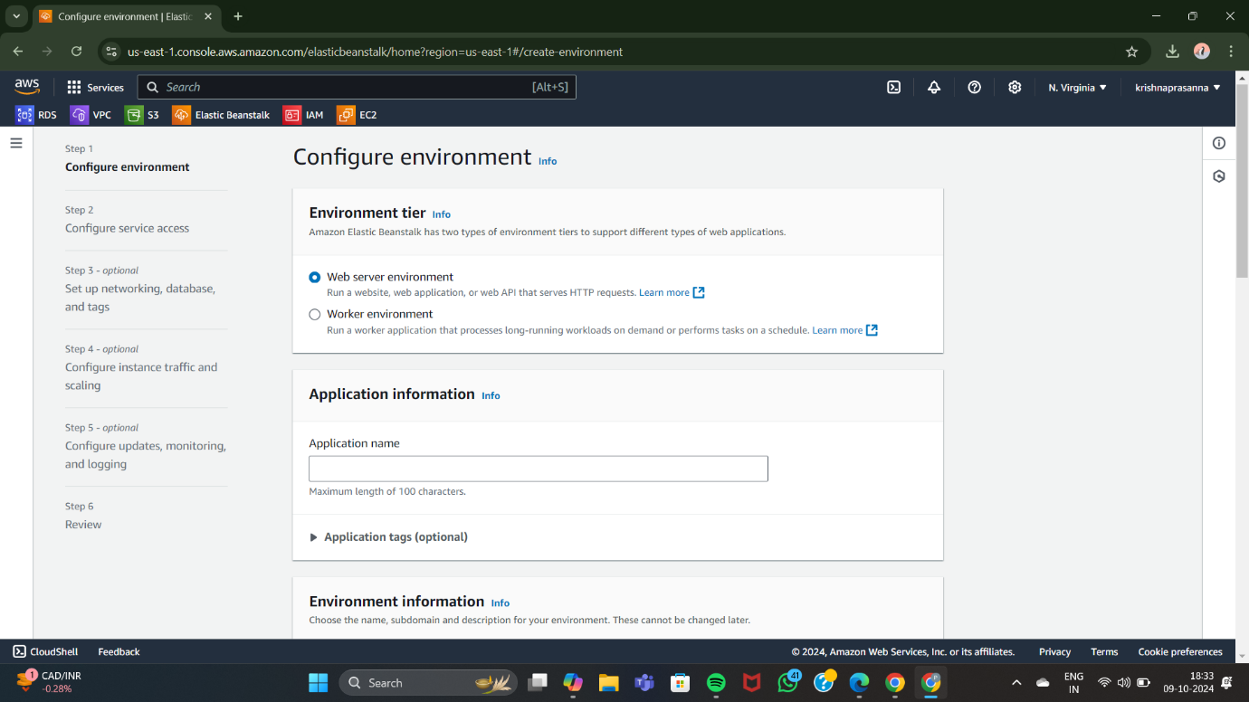
Assignment Setup:
Create application in AWS Elastic Beanstalk :

Slide 5
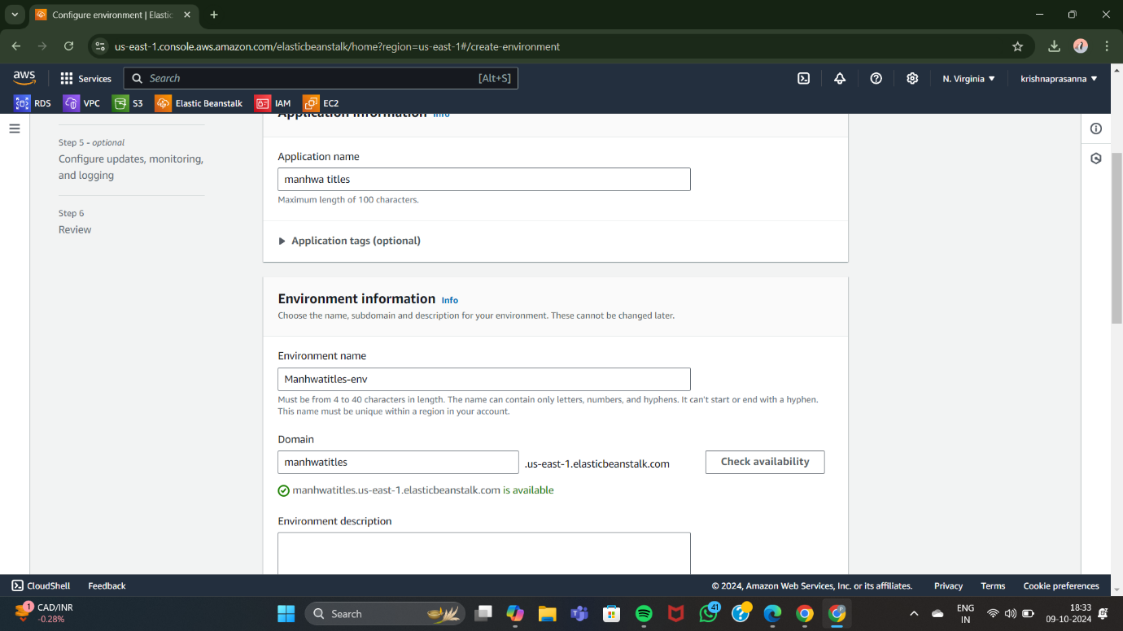
Configure environment:

Slide 6
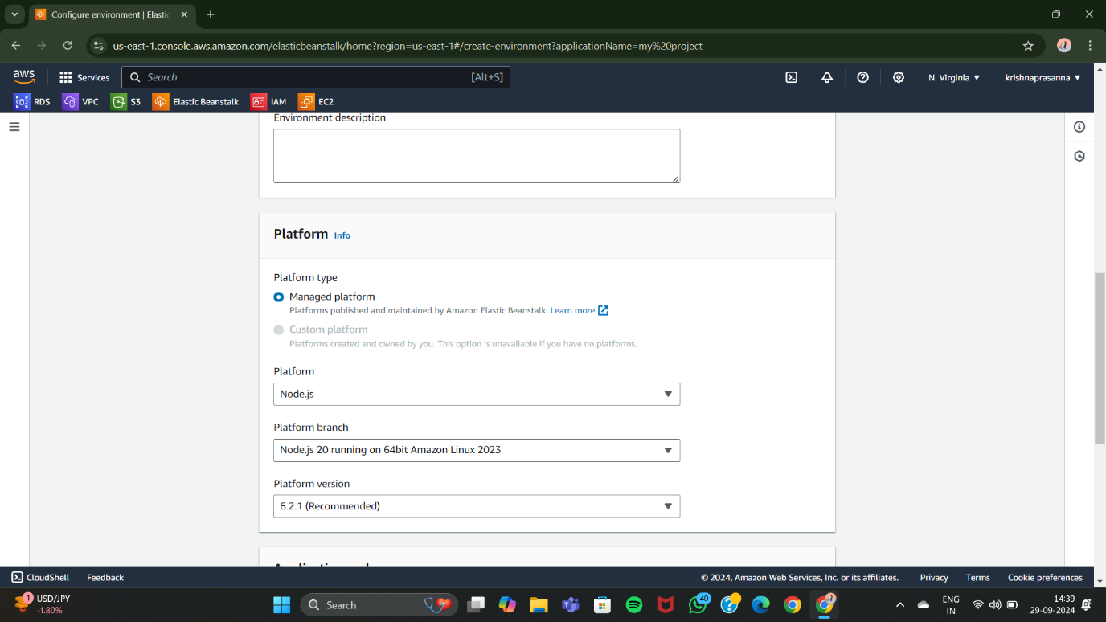
Platform selected - Node.js:

Slide 7
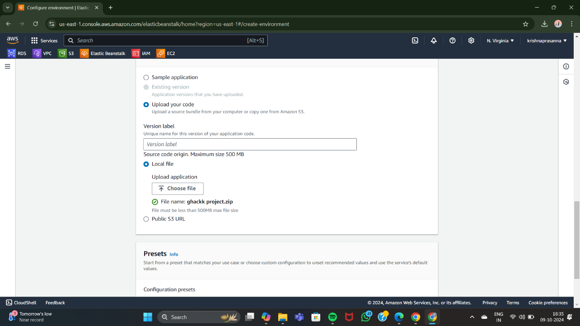
Web application code uploaded:

Slide 8
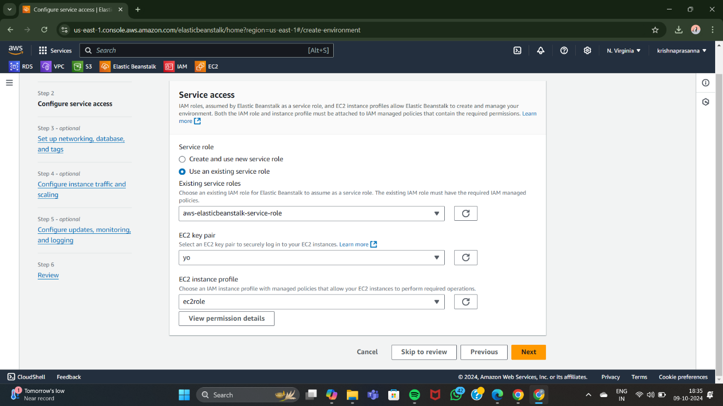
Service role created and applied
EC2 key pair created and applied
EC2 role created and applied

Slide 9
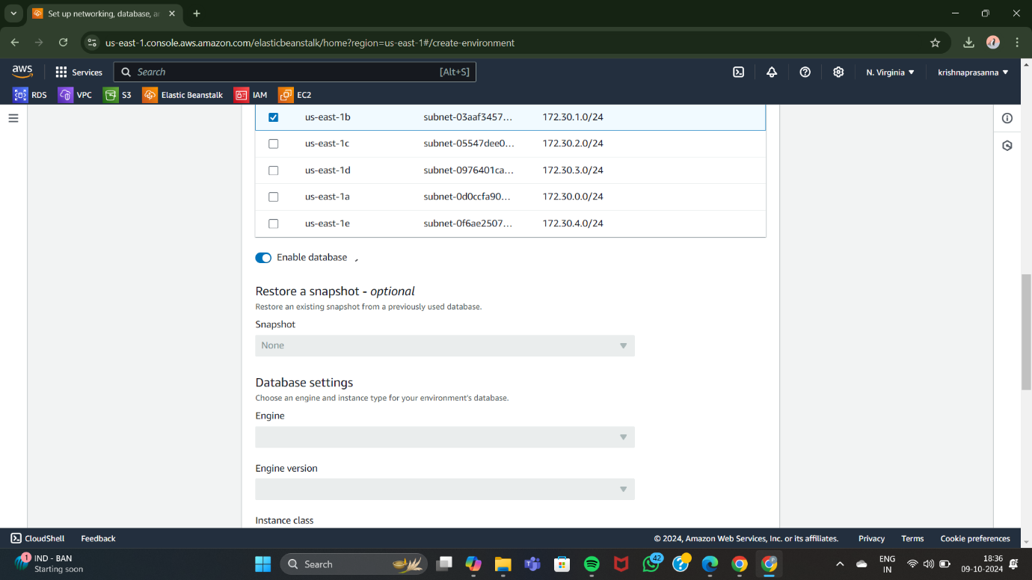
Subnets selected as required in the regions:

Slide 10
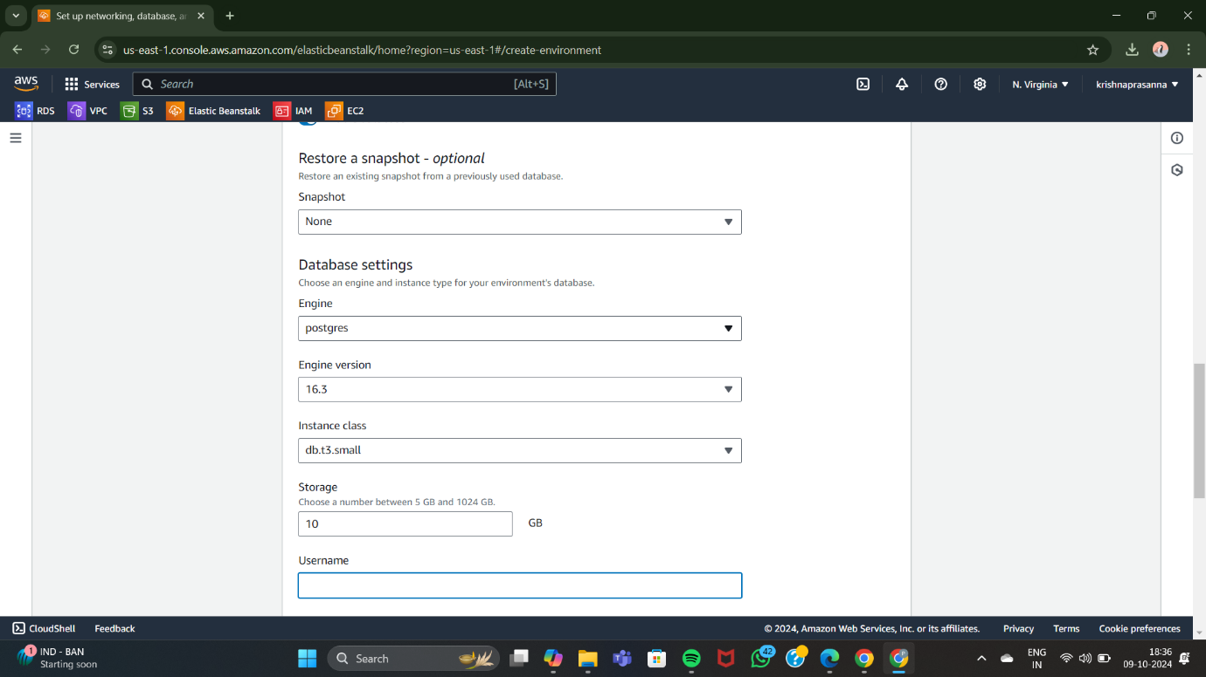
Database connected:

Slide 11
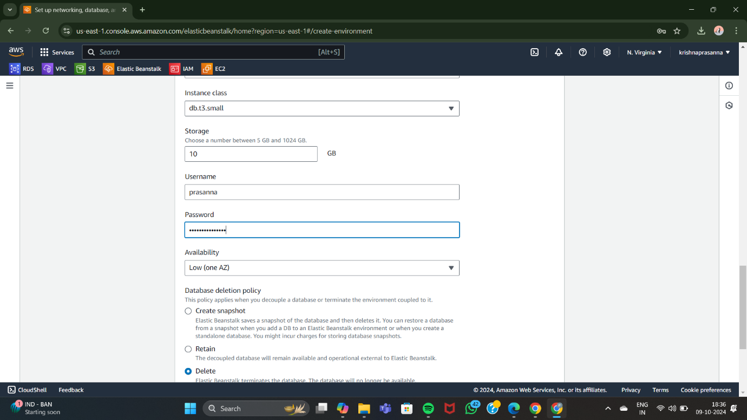
Set Username and password :

Slide 12
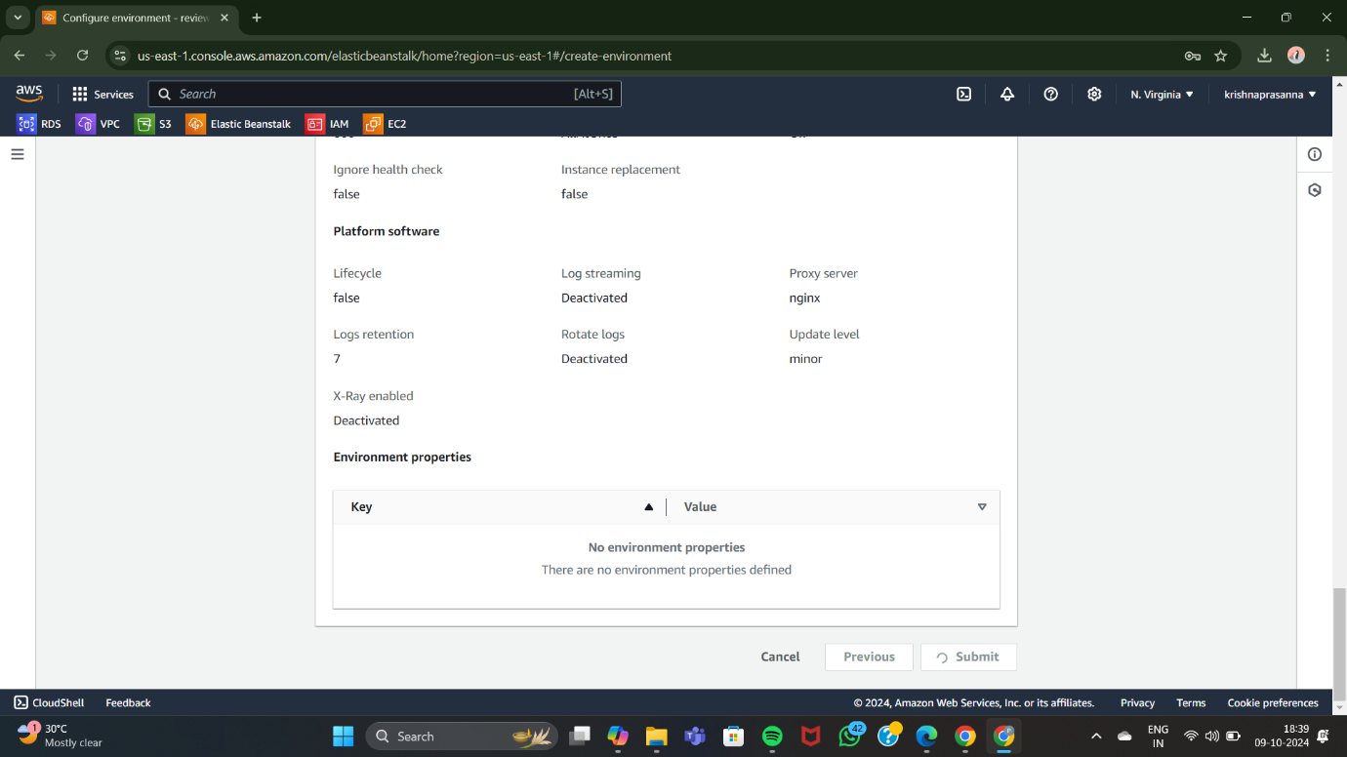
Configure the environment and review after all the steps :
Create and submit:

Slide 13
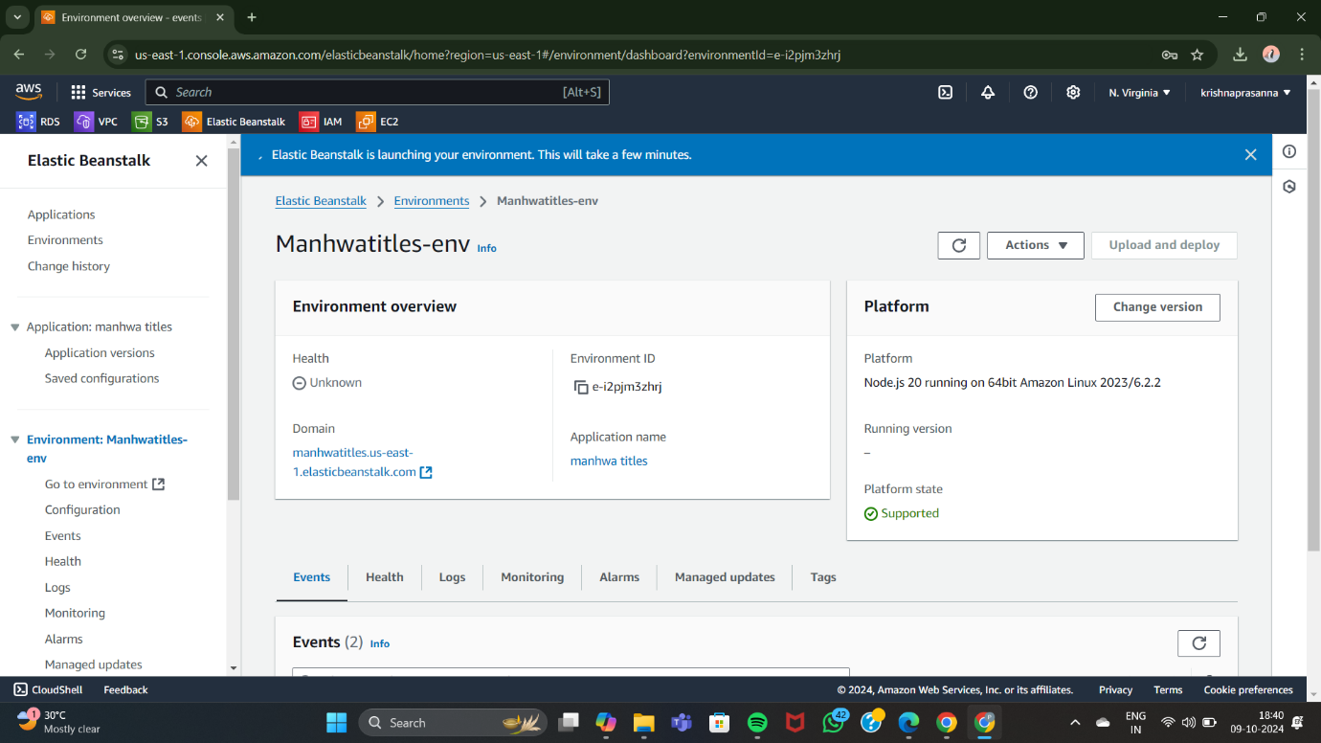
Your application takes time to deploy …wait for a while:

Slide 14
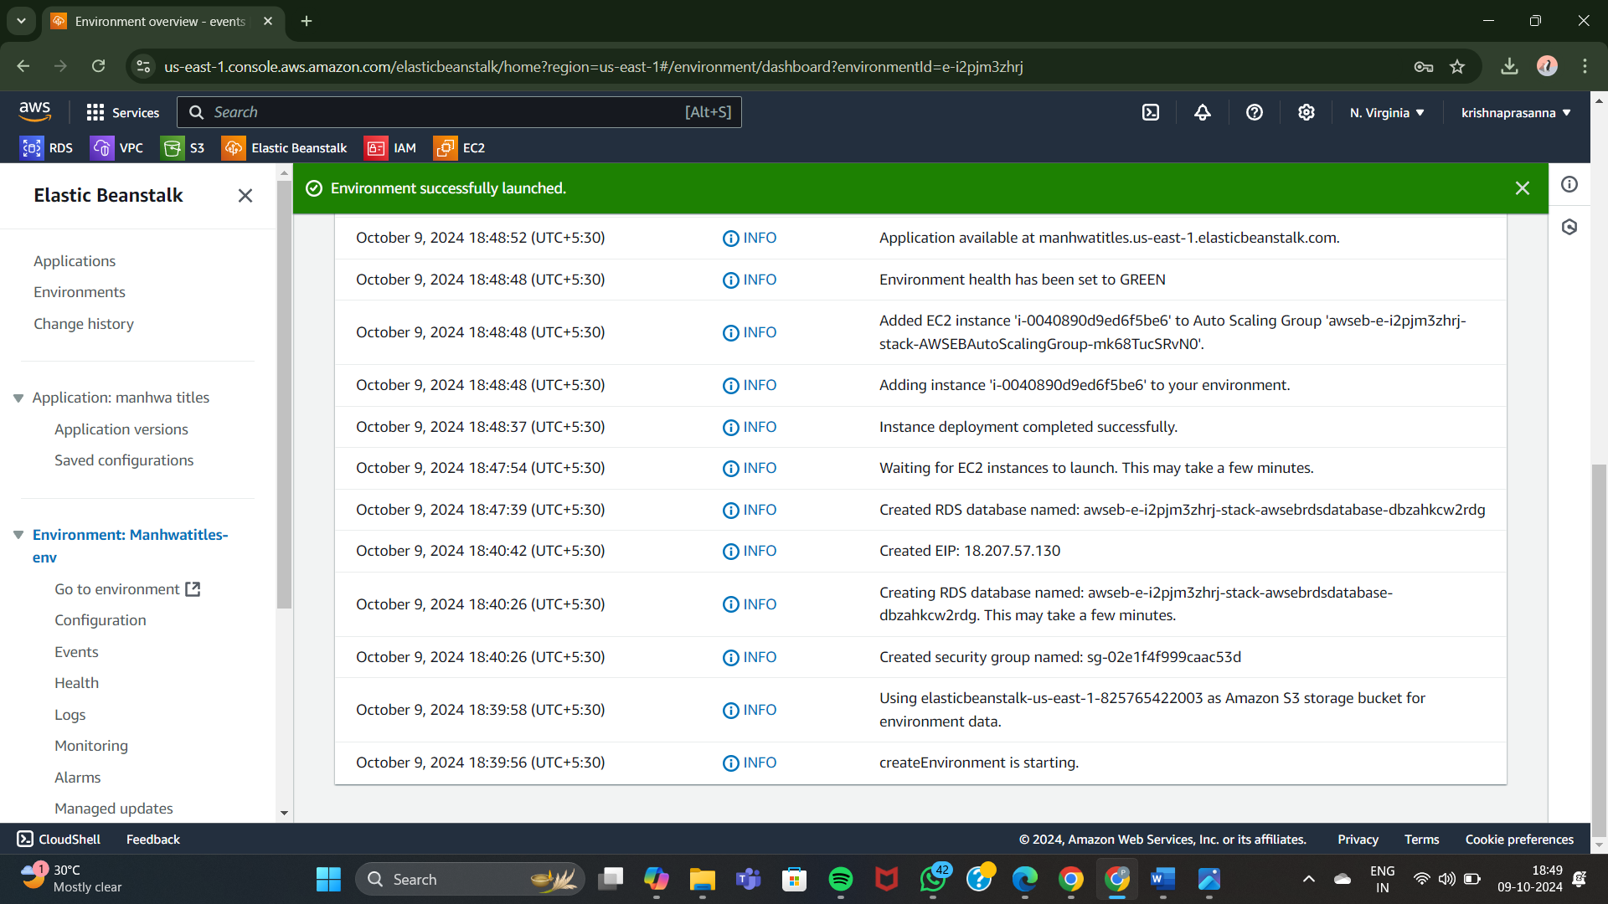
Check the events log so you will get you know what’s happening…:

Slide 15
After the deployment now you will get the domain link ,click on it :

Slide 16
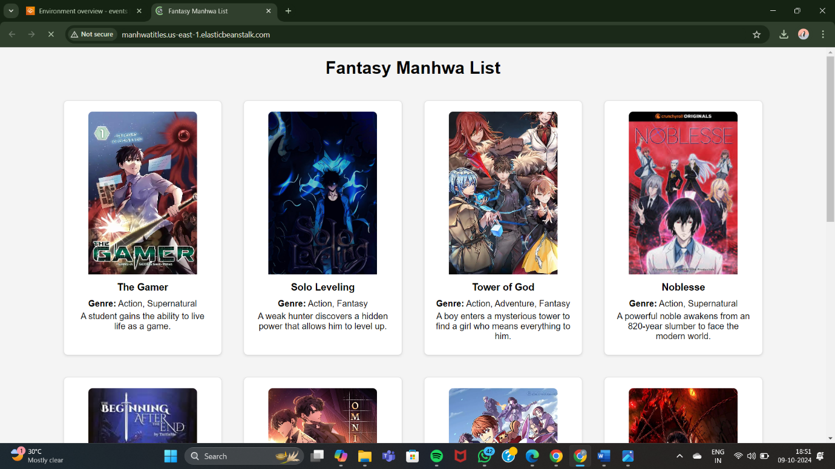
Web application created:

Slide 17
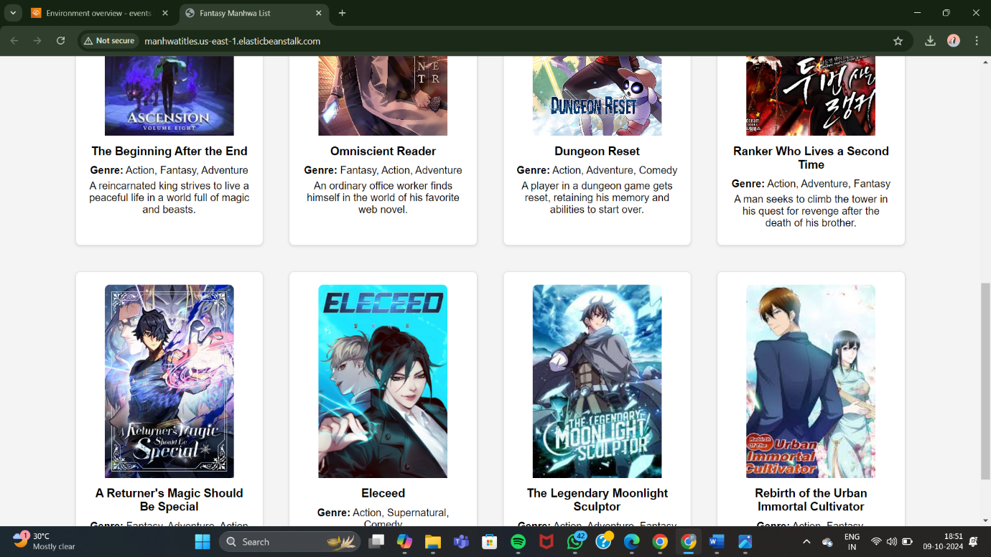

Slide 18
Assignment Resources/ Reference:
AWS Elastic Beanstalk
https://aws.amazon.com/elasticbeanstalk/
Amazon S3
https://aws.amazon.com/s3/
Amazon EC2
https://aws.amazon.com/ec2/
Amazon RDS
https://docs.aws.amazon.com/AmazonRDS/latest/UserGuide/Welcome.html
IAM
https://docs.aws.amazon.com/IAM/latest/UserGuide/introduction.html
AWS Key Management Service
https://docs.aws.amazon.com/kms/latest/developerguide/overview.html

Slide 19
Thank you

